Slide 1
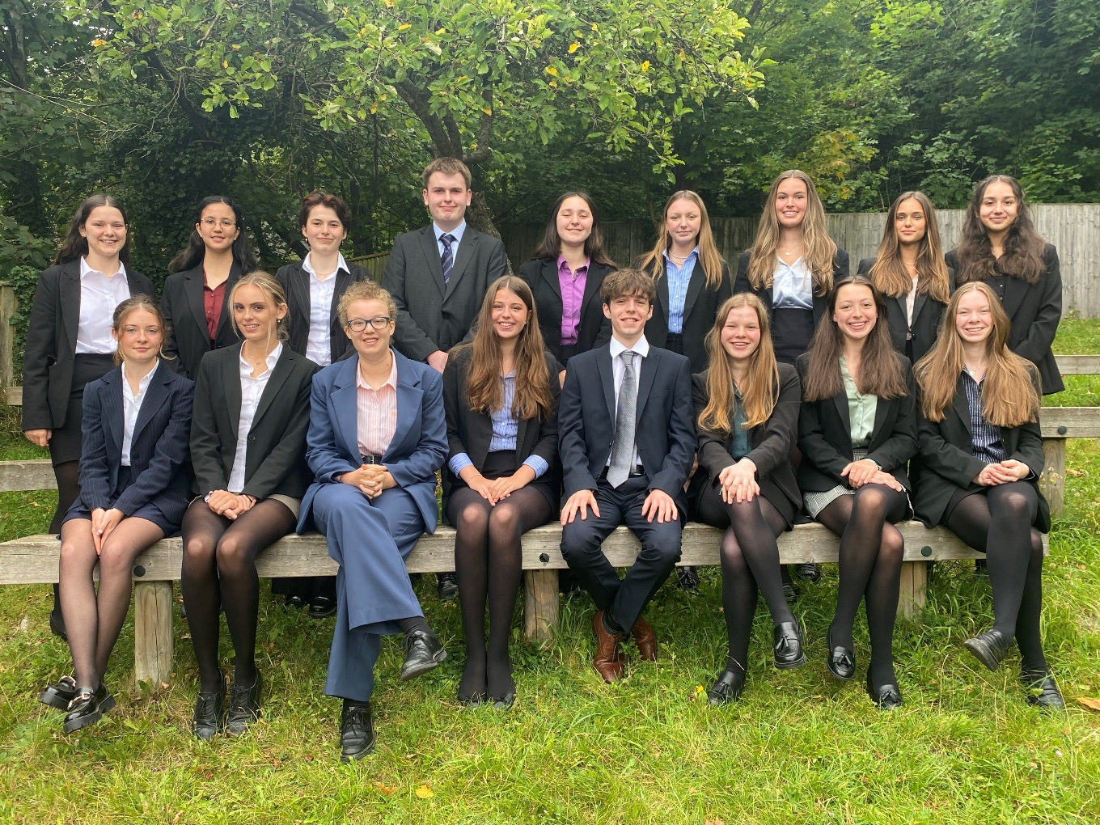
Drama Leaders

Slide 2
Why take on a drama leadership role?
Gives you valuable leadership experience
Helps you build your organisation and time-management skills
Is an excellent addition to any further education application
Allows you to explore an area of interest in more depth
You’re passionate about theatre and want to share your enjoyment and expertise with younger year groups
It’s fun!

Slide 3
What roles are available?
Drama Captain(s)
Tech Captain
Director(s): Sixth Form Play
Assistant Director: School Play
Assistant Director: Lower School Musical
Assistant Director: TIE Tour
Primary School Drama Club Leaders

Slide 4
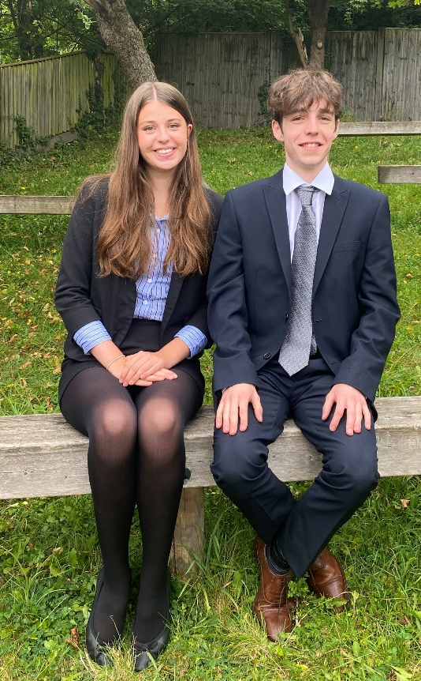
Drama Captain(s)
Role:
Regular meetings with Miss Guttner to discuss how to improve the department, upcoming events etc.
Advertise clubs, productions etc in assemblies
Spread the drama love & encourage pupils to get involved
Compere the Orchard Theatre Festival
Help with Front of House/Backstage where needed
Person Specification:
Committed to the department
Love Drama/Performing Arts
Organised, creative, friendly and approachable!

Slide 5
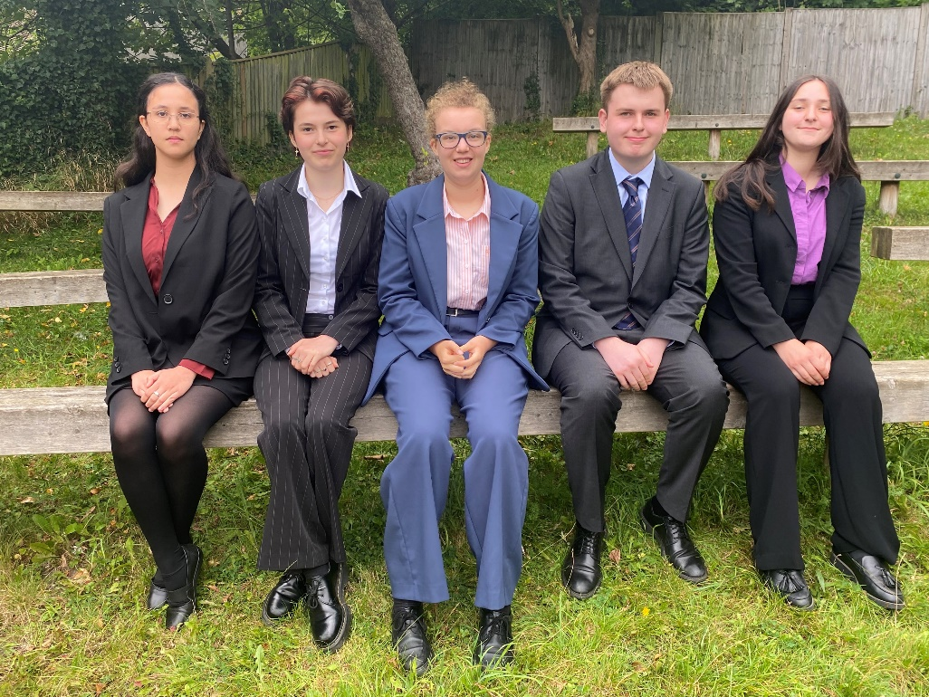
TECH Captain(S)
Person Specification:
Experience backstage
Interest in technical aspects of theatre.
Could be artistic, with an interest in making and designing
Disciplined and willing to pitch in where necessary
Role:
Help run tech club
Mentor younger pupils in all things tech
Work backstage on the productions

Slide 6
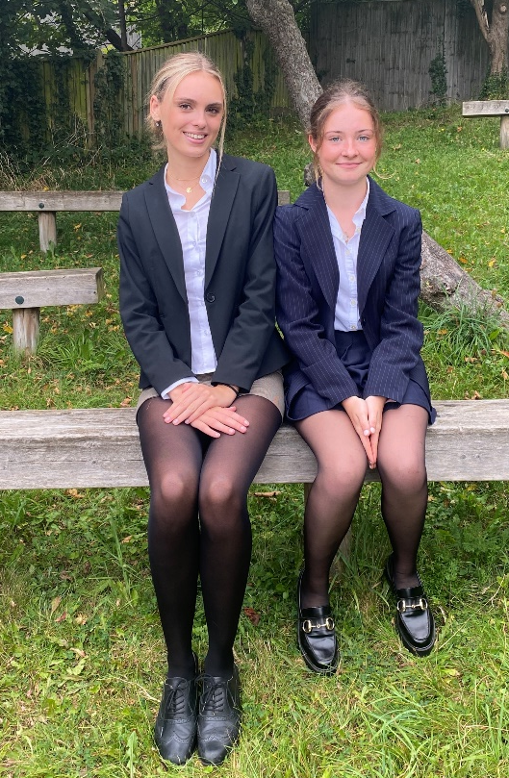
Director(s):
Sixth Form Play
Role:
Choose what to stage as the Sixth Form Play
Create a directorial concept & overall vision for the production
Create a rehearsal schedule that suits the whole cast
Lead rehearsals and direct actors
Work with the tech team to design set/lighting/sound
Person Specification:
Confident leader, ready to take charge & shape a production
Performance or directing experience
Creative
Work productively with others

Slide 7
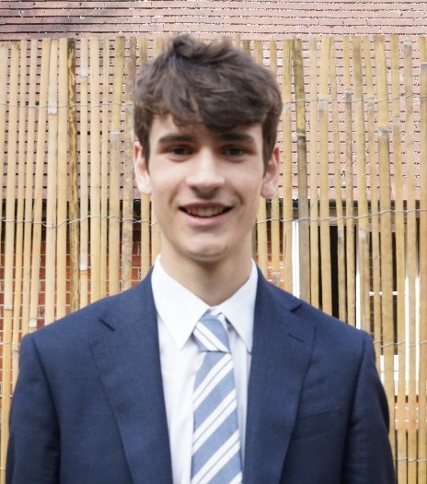
Assistant Director:
School Play
Role
Support the director as need be
Run rehearsals with small groups/individuals
Make notes on blocking
Stand in when actors are absent & then fill them in later
Be a liaison between cast & director
Person Specification:
Keen interest in learning about directing.
Experience of performance
Be professional, discreet, reliable and supportive.

Slide 8
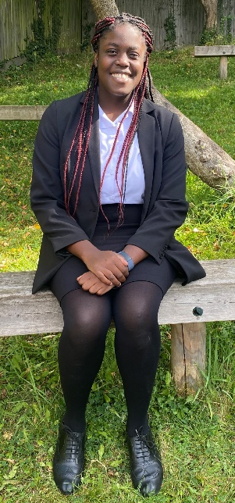
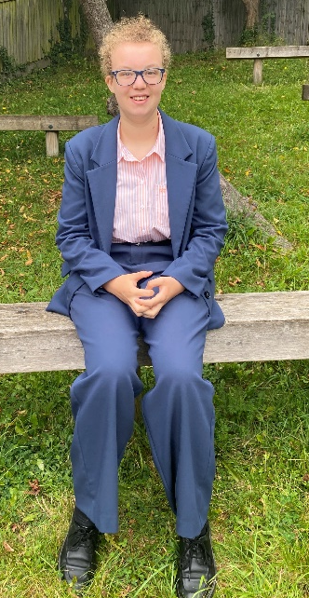
Assistant Director:
Lower School Musical
Role
Support the director as need be
Run rehearsals with small groups/individuals
Make notes on blocking
Stand in when actors are absent & then fill them in later
Be a liaison between cast & director
Person Specification:
Keen interest in learning about directing.
Experience of performing in a musical.
Being able to sing and/or dance would be helpful

Slide 9
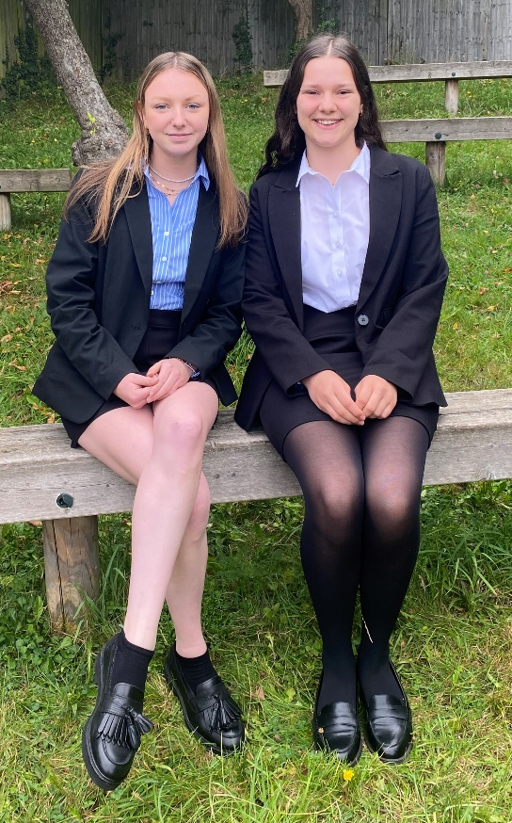
Assistant Director:
TIE TOUR
Person Specification:
Enjoy working with younger students.
Enjoy devising
Reliable, resourceful and organised
Empathetic, thoughtful and understanding
Role
Working with the Third Years to stage a piece of Theatre in Education.
Run warm-ups
Run rehearsals with small groups
Support the director as need be

Slide 10
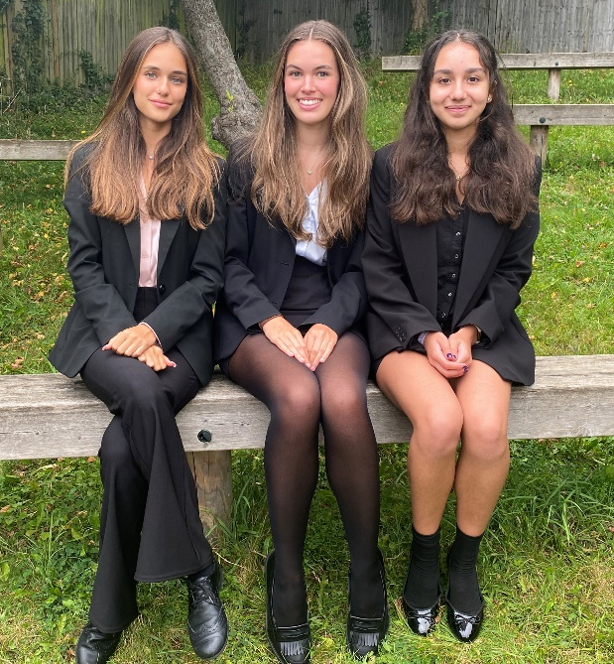
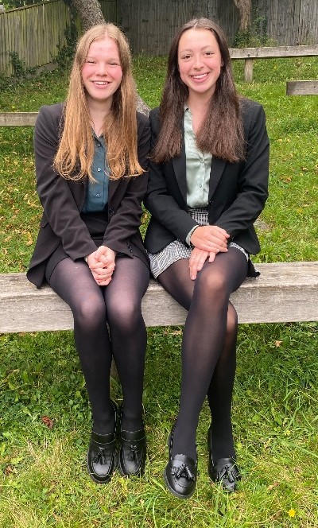
Primary School Drama Club Leaders & PREP LAMDA Helpers
Person Specification:
Enjoy working with young children. Experience would be a bonus!
Energetic, enthusiastic and creative.
Patient, supportive and encouraging
Confident and organised
Role
Working with young children to improve their performance skills
Leading fun and energetic games and warm ups
Coming up with exercises and tasks for them to complete
(Drama Club) Working towards a showcase for parents

Slide 11
What now?
Write a personal statement outlining your suitability for the role (or roles!) you would like to apply for.
Email it to our Director of Drama, Miss Guttner: gabi.guttner@caterhamschool.co.uk
Deadline to apply is 4pm on Friday 5th July.

